Slide 1
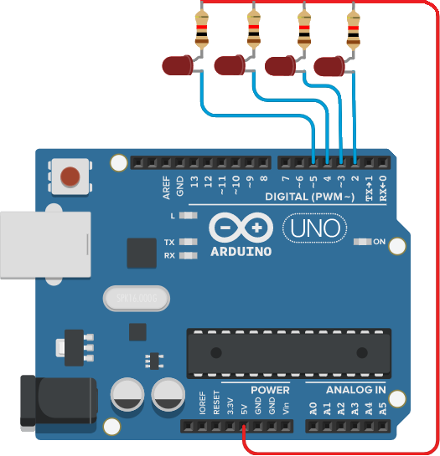
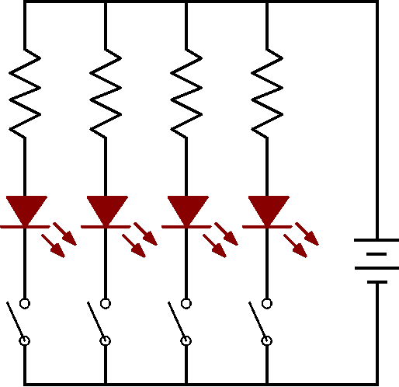
LED 排燈控制
void setup() {
pinMode(2, OUTPUT);
pinMode(3, OUTPUT);
pinMode(4, OUTPUT);
pinMode(5, OUTPUT);
digitalWrite(2, HIGH);
digitalWrite(3, HIGH);
digitalWrite(4, HIGH);
digitalWrite(5, HIGH);
}
void loop() {
digitalWrite(2, LOW);
delay(500);
digitalWrite(2, HIGH);
digitalWrite(3, LOW);
delay(500);
digitalWrite(3, HIGH);
digitalWrite(4, LOW);
delay(500);
digitalWrite(4, HIGH);
digitalWrite(5, LOW);
delay(500);
digitalWrite(5, HIGH);
}

Slide 2
LED 排燈控制
void setup() {
pinMode(2, OUTPUT);
pinMode(3, OUTPUT);
pinMode(4, OUTPUT);
pinMode(5, OUTPUT);
digitalWrite(2, HIGH);
digitalWrite(3, HIGH);
digitalWrite(4, HIGH);
digitalWrite(5, HIGH);
}
void loop() {
digitalWrite(2, LOW);
delay(500);
digitalWrite(2, HIGH);
digitalWrite(3, LOW);
delay(500);
digitalWrite(3, HIGH);
digitalWrite(4, LOW);
delay(500);
digitalWrite(4, HIGH);
digitalWrite(5, LOW);
delay(500);
digitalWrite(5, HIGH);
}
2

Slide 3
LED 排燈控制
void setup() {
pinMode(2, OUTPUT);
pinMode(3, OUTPUT);
pinMode(4, OUTPUT);
pinMode(5, OUTPUT);
digitalWrite(2, HIGH);
digitalWrite(3, HIGH);
digitalWrite(4, HIGH);
digitalWrite(5, HIGH);
}
void loop() {
digitalWrite(2, LOW);
delay(500);
digitalWrite(2, HIGH);
digitalWrite(3, LOW);
delay(500);
digitalWrite(3, HIGH);
digitalWrite(4, LOW);
delay(500);
digitalWrite(4, HIGH);
digitalWrite(5, LOW);
delay(500);
digitalWrite(5, HIGH);
}
3
2

Slide 4
LED 排燈控制
void setup() {
pinMode(2, OUTPUT);
pinMode(3, OUTPUT);
pinMode(4, OUTPUT);
pinMode(5, OUTPUT);
digitalWrite(2, HIGH);
digitalWrite(3, HIGH);
digitalWrite(4, HIGH);
digitalWrite(5, HIGH);
}
void loop() {
digitalWrite(2, LOW);
delay(500);
digitalWrite(2, HIGH);
digitalWrite(3, LOW);
delay(500);
digitalWrite(3, HIGH);
digitalWrite(4, LOW);
delay(500);
digitalWrite(4, HIGH);
digitalWrite(5, LOW);
delay(500);
digitalWrite(5, HIGH);
}
4
3
2

Slide 5
LED 排燈控制
void setup() {
pinMode(2, OUTPUT);
pinMode(3, OUTPUT);
pinMode(4, OUTPUT);
pinMode(5, OUTPUT);
digitalWrite(2, HIGH);
digitalWrite(3, HIGH);
digitalWrite(4, HIGH);
digitalWrite(5, HIGH);
}
void loop() {
digitalWrite(2, LOW);
delay(500);
digitalWrite(2, HIGH);
digitalWrite(3, LOW);
delay(500);
digitalWrite(3, HIGH);
digitalWrite(4, LOW);
delay(500);
digitalWrite(4, HIGH);
digitalWrite(5, LOW);
delay(500);
digitalWrite(5, HIGH);
}
5
4
3
2

Slide 6
LED 排燈控制
void setup() {
pinMode(2, OUTPUT);
pinMode(3, OUTPUT);
pinMode(4, OUTPUT);
pinMode(5, OUTPUT);
digitalWrite(2, HIGH);
digitalWrite(3, HIGH);
digitalWrite(4, HIGH);
digitalWrite(5, HIGH);
}
void loop() {
digitalWrite(2, LOW);
delay(500);
digitalWrite(2, HIGH);
digitalWrite(3, LOW);
delay(500);
digitalWrite(3, HIGH);
digitalWrite(4, LOW);
delay(500);
digitalWrite(4, HIGH);
digitalWrite(5, LOW);
delay(500);
digitalWrite(5, HIGH);
}
5
4
3
2

Slide 7
LED 排燈控制
void setup() {
pinMode(2, OUTPUT);
pinMode(3, OUTPUT);
pinMode(4, OUTPUT);
pinMode(5, OUTPUT);
digitalWrite(2, HIGH);
digitalWrite(3, HIGH);
digitalWrite(4, HIGH);
digitalWrite(5, HIGH);
}
void loop() {
digitalWrite(2, LOW);
delay(500);
digitalWrite(2, HIGH);
digitalWrite(3, LOW);
delay(500);
digitalWrite(3, HIGH);
digitalWrite(4, LOW);
delay(500);
digitalWrite(4, HIGH);
digitalWrite(5, LOW);
delay(500);
digitalWrite(5, HIGH);
}
5
4
3
2

Slide 8
LED 排燈控制
void setup() {
pinMode(2, OUTPUT);
pinMode(3, OUTPUT);
pinMode(4, OUTPUT);
pinMode(5, OUTPUT);
digitalWrite(2, HIGH);
digitalWrite(3, HIGH);
digitalWrite(4, HIGH);
digitalWrite(5, HIGH);
}
void loop() {
digitalWrite(2, LOW);
delay(500);
digitalWrite(2, HIGH);
digitalWrite(3, LOW);
delay(500);
digitalWrite(3, HIGH);
digitalWrite(4, LOW);
delay(500);
digitalWrite(4, HIGH);
digitalWrite(5, LOW);
delay(500);
digitalWrite(5, HIGH);
}
5
4
3
2

Slide 9
LED 排燈控制
void setup() {
pinMode(2, OUTPUT);
pinMode(3, OUTPUT);
pinMode(4, OUTPUT);
pinMode(5, OUTPUT);
digitalWrite(2, HIGH);
digitalWrite(3, HIGH);
digitalWrite(4, HIGH);
digitalWrite(5, HIGH);
}
void loop() {
digitalWrite(2, LOW);
delay(500);
digitalWrite(2, HIGH);
digitalWrite(3, LOW);
delay(500);
digitalWrite(3, HIGH);
digitalWrite(4, LOW);
delay(500);
digitalWrite(4, HIGH);
digitalWrite(5, LOW);
delay(500);
digitalWrite(5, HIGH);
}
5
4
3
2

Slide 10
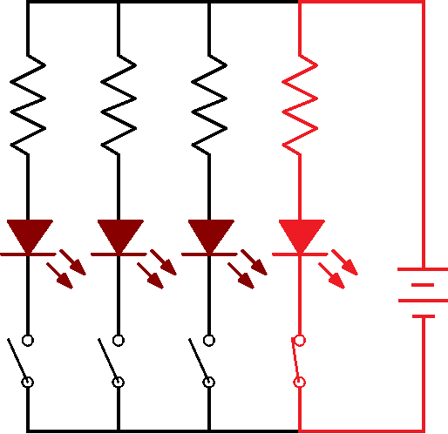
LED 排燈控制
void setup() {
pinMode(2, OUTPUT);
pinMode(3, OUTPUT);
pinMode(4, OUTPUT);
pinMode(5, OUTPUT);
digitalWrite(2, HIGH);
digitalWrite(3, HIGH);
digitalWrite(4, HIGH);
digitalWrite(5, HIGH);
}
void loop() {
digitalWrite(2, LOW);
delay(500);
digitalWrite(2, HIGH);
digitalWrite(3, LOW);
delay(500);
digitalWrite(3, HIGH);
digitalWrite(4, LOW);
delay(500);
digitalWrite(4, HIGH);
digitalWrite(5, LOW);
delay(500);
digitalWrite(5, HIGH);
}
5
4
3
2

Slide 11
LED 排燈控制
void setup() {
pinMode(2, OUTPUT);
pinMode(3, OUTPUT);
pinMode(4, OUTPUT);
pinMode(5, OUTPUT);
digitalWrite(2, HIGH);
digitalWrite(3, HIGH);
digitalWrite(4, HIGH);
digitalWrite(5, HIGH);
}
void loop() {
digitalWrite(2, LOW);
delay(500);
digitalWrite(2, HIGH);
digitalWrite(3, LOW);
delay(500);
digitalWrite(3, HIGH);
digitalWrite(4, LOW);
delay(500);
digitalWrite(4, HIGH);
digitalWrite(5, LOW);
delay(500);
digitalWrite(5, HIGH);
}
5
4
3
2

Slide 12
LED 排燈控制
void setup() {
pinMode(2, OUTPUT);
pinMode(3, OUTPUT);
pinMode(4, OUTPUT);
pinMode(5, OUTPUT);
digitalWrite(2, HIGH);
digitalWrite(3, HIGH);
digitalWrite(4, HIGH);
digitalWrite(5, HIGH);
}
void loop() {
digitalWrite(2, LOW);
delay(500);
digitalWrite(2, HIGH);
digitalWrite(3, LOW);
delay(500);
digitalWrite(3, HIGH);
digitalWrite(4, LOW);
delay(500);
digitalWrite(4, HIGH);
digitalWrite(5, LOW);
delay(500);
digitalWrite(5, HIGH);
}
5
4
3
2

Slide 13
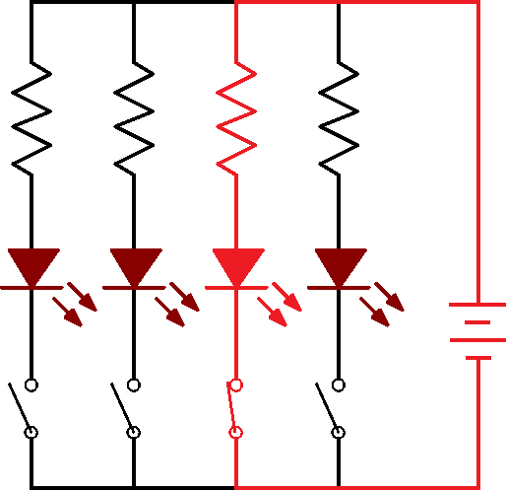
LED 排燈控制
void setup() {
pinMode(2, OUTPUT);
pinMode(3, OUTPUT);
pinMode(4, OUTPUT);
pinMode(5, OUTPUT);
digitalWrite(2, HIGH);
digitalWrite(3, HIGH);
digitalWrite(4, HIGH);
digitalWrite(5, HIGH);
}
void loop() {
digitalWrite(2, LOW);
delay(500);
digitalWrite(2, HIGH);
digitalWrite(3, LOW);
delay(500);
digitalWrite(3, HIGH);
digitalWrite(4, LOW);
delay(500);
digitalWrite(4, HIGH);
digitalWrite(5, LOW);
delay(500);
digitalWrite(5, HIGH);
}
5
4
3
2

Slide 14
LED 排燈控制
void setup() {
pinMode(2, OUTPUT);
pinMode(3, OUTPUT);
pinMode(4, OUTPUT);
pinMode(5, OUTPUT);
digitalWrite(2, HIGH);
digitalWrite(3, HIGH);
digitalWrite(4, HIGH);
digitalWrite(5, HIGH);
}
void loop() {
digitalWrite(2, LOW);
delay(500);
digitalWrite(2, HIGH);
digitalWrite(3, LOW);
delay(500);
digitalWrite(3, HIGH);
digitalWrite(4, LOW);
delay(500);
digitalWrite(4, HIGH);
digitalWrite(5, LOW);
delay(500);
digitalWrite(5, HIGH);
}
5
4
3
2

Slide 15
LED 排燈控制
void setup() {
pinMode(2, OUTPUT);
pinMode(3, OUTPUT);
pinMode(4, OUTPUT);
pinMode(5, OUTPUT);
digitalWrite(2, HIGH);
digitalWrite(3, HIGH);
digitalWrite(4, HIGH);
digitalWrite(5, HIGH);
}
void loop() {
digitalWrite(2, LOW);
delay(500);
digitalWrite(2, HIGH);
digitalWrite(3, LOW);
delay(500);
digitalWrite(3, HIGH);
digitalWrite(4, LOW);
delay(500);
digitalWrite(4, HIGH);
digitalWrite(5, LOW);
delay(500);
digitalWrite(5, HIGH);
}
5
4
3
2

Slide 16
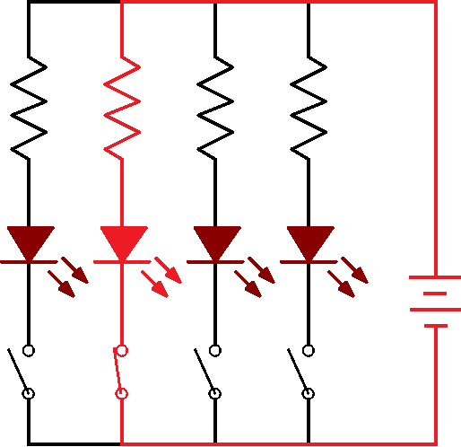
LED 排燈控制
void setup() {
pinMode(2, OUTPUT);
pinMode(3, OUTPUT);
pinMode(4, OUTPUT);
pinMode(5, OUTPUT);
digitalWrite(2, HIGH);
digitalWrite(3, HIGH);
digitalWrite(4, HIGH);
digitalWrite(5, HIGH);
}
void loop() {
digitalWrite(2, LOW);
delay(500);
digitalWrite(2, HIGH);
digitalWrite(3, LOW);
delay(500);
digitalWrite(3, HIGH);
digitalWrite(4, LOW);
delay(500);
digitalWrite(4, HIGH);
digitalWrite(5, LOW);
delay(500);
digitalWrite(5, HIGH);
}
5
4
3
2

Slide 17
LED 排燈控制
void setup() {
pinMode(2, OUTPUT);
pinMode(3, OUTPUT);
pinMode(4, OUTPUT);
pinMode(5, OUTPUT);
digitalWrite(2, HIGH);
digitalWrite(3, HIGH);
digitalWrite(4, HIGH);
digitalWrite(5, HIGH);
}
void loop() {
digitalWrite(2, LOW);
delay(500);
digitalWrite(2, HIGH);
digitalWrite(3, LOW);
delay(500);
digitalWrite(3, HIGH);
digitalWrite(4, LOW);
delay(500);
digitalWrite(4, HIGH);
digitalWrite(5, LOW);
delay(500);
digitalWrite(5, HIGH);
}
5
4
3
2

Slide 18
LED 排燈控制
void setup() {
pinMode(2, OUTPUT);
pinMode(3, OUTPUT);
pinMode(4, OUTPUT);
pinMode(5, OUTPUT);
digitalWrite(2, HIGH);
digitalWrite(3, HIGH);
digitalWrite(4, HIGH);
digitalWrite(5, HIGH);
}
void loop() {
digitalWrite(2, LOW);
delay(500);
digitalWrite(2, HIGH);
digitalWrite(3, LOW);
delay(500);
digitalWrite(3, HIGH);
digitalWrite(4, LOW);
delay(500);
digitalWrite(4, HIGH);
digitalWrite(5, LOW);
delay(500);
digitalWrite(5, HIGH);
}
5
4
3
2

Slide 19
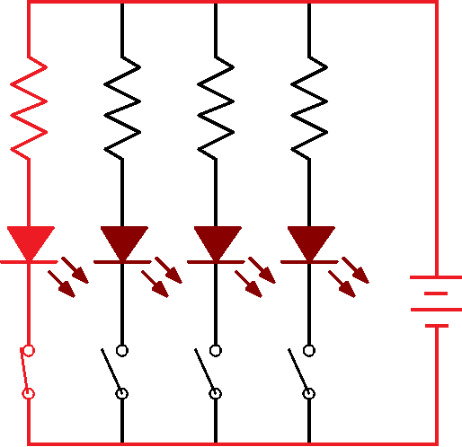
LED 排燈控制
void setup() {
pinMode(2, OUTPUT);
pinMode(3, OUTPUT);
pinMode(4, OUTPUT);
pinMode(5, OUTPUT);
digitalWrite(2, HIGH);
digitalWrite(3, HIGH);
digitalWrite(4, HIGH);
digitalWrite(5, HIGH);
}
void loop() {
digitalWrite(2, LOW);
delay(500);
digitalWrite(2, HIGH);
digitalWrite(3, LOW);
delay(500);
digitalWrite(3, HIGH);
digitalWrite(4, LOW);
delay(500);
digitalWrite(4, HIGH);
digitalWrite(5, LOW);
delay(500);
digitalWrite(5, HIGH);
}
5
4
3
2

Slide 20
LED 排燈控制
void setup() {
pinMode(2, OUTPUT);
pinMode(3, OUTPUT);
pinMode(4, OUTPUT);
pinMode(5, OUTPUT);
digitalWrite(2, HIGH);
digitalWrite(3, HIGH);
digitalWrite(4, HIGH);
digitalWrite(5, HIGH);
}
void loop() {
digitalWrite(2, LOW);
delay(500);
digitalWrite(2, HIGH);
digitalWrite(3, LOW);
delay(500);
digitalWrite(3, HIGH);
digitalWrite(4, LOW);
delay(500);
digitalWrite(4, HIGH);
digitalWrite(5, LOW);
delay(500);
digitalWrite(5, HIGH);
}
5
4
3
2

Slide 21
LED 排燈控制
void setup() {
pinMode(2, OUTPUT);
pinMode(3, OUTPUT);
pinMode(4, OUTPUT);
pinMode(5, OUTPUT);
digitalWrite(2, HIGH);
digitalWrite(3, HIGH);
digitalWrite(4, HIGH);
digitalWrite(5, HIGH);
}
void loop() {
digitalWrite(2, LOW);
delay(500);
digitalWrite(2, HIGH);
digitalWrite(3, LOW);
delay(500);
digitalWrite(3, HIGH);
digitalWrite(4, LOW);
delay(500);
digitalWrite(4, HIGH);
digitalWrite(5, LOW);
delay(500);
digitalWrite(5, HIGH);
}
5
4
3
2

Slide 22
LED 排燈控制
void setup() {
pinMode(2, OUTPUT);
pinMode(3, OUTPUT);
pinMode(4, OUTPUT);
pinMode(5, OUTPUT);
digitalWrite(2, HIGH);
digitalWrite(3, HIGH);
digitalWrite(4, HIGH);
digitalWrite(5, HIGH);
}
void loop() {
digitalWrite(2, LOW);
delay(500);
digitalWrite(2, HIGH);
digitalWrite(3, LOW);
delay(500);
digitalWrite(3, HIGH);
digitalWrite(4, LOW);
delay(500);
digitalWrite(4, HIGH);
digitalWrite(5, LOW);
delay(500);
digitalWrite(5, HIGH);
}
5
4
3
2

Slide 23
LED 排燈控制
void setup() {
pinMode(2, OUTPUT);
pinMode(3, OUTPUT);
pinMode(4, OUTPUT);
pinMode(5, OUTPUT);
digitalWrite(2, HIGH);
digitalWrite(3, HIGH);
digitalWrite(4, HIGH);
digitalWrite(5, HIGH);
}
void loop() {
digitalWrite(2, LOW);
delay(500);
digitalWrite(2, HIGH);
digitalWrite(3, LOW);
delay(500);
digitalWrite(3, HIGH);
digitalWrite(4, LOW);
delay(500);
digitalWrite(4, HIGH);
digitalWrite(5, LOW);
delay(500);
digitalWrite(5, HIGH);
}
5
4
3
2

Slide 24
LED 排燈控制
void setup() {
pinMode(2, OUTPUT);
pinMode(3, OUTPUT);
pinMode(4, OUTPUT);
pinMode(5, OUTPUT);
digitalWrite(2, HIGH);
digitalWrite(3, HIGH);
digitalWrite(4, HIGH);
digitalWrite(5, HIGH);
}
void loop() {
digitalWrite(2, LOW);
delay(500);
digitalWrite(2, HIGH);
digitalWrite(3, LOW);
delay(500);
digitalWrite(3, HIGH);
digitalWrite(4, LOW);
delay(500);
digitalWrite(4, HIGH);
digitalWrite(5, LOW);
delay(500);
digitalWrite(5, HIGH);
}
5
4
3
2

Slide 25
LED 排燈控制
void setup() {
pinMode(2, OUTPUT);
pinMode(3, OUTPUT);
pinMode(4, OUTPUT);
pinMode(5, OUTPUT);
digitalWrite(2, HIGH);
digitalWrite(3, HIGH);
digitalWrite(4, HIGH);
digitalWrite(5, HIGH);
}
void loop() {
digitalWrite(2, LOW);
delay(500);
digitalWrite(2, HIGH);
digitalWrite(3, LOW);
delay(500);
digitalWrite(3, HIGH);
digitalWrite(4, LOW);
delay(500);
digitalWrite(4, HIGH);
digitalWrite(5, LOW);
delay(500);
digitalWrite(5, HIGH);
}
5
4
3
2

Slide 26
LED 排燈控制
void setup() {
pinMode(2, OUTPUT);
pinMode(3, OUTPUT);
pinMode(4, OUTPUT);
pinMode(5, OUTPUT);
digitalWrite(2, HIGH);
digitalWrite(3, HIGH);
digitalWrite(4, HIGH);
digitalWrite(5, HIGH);
}
void loop() {
digitalWrite(2, LOW);
delay(500);
digitalWrite(2, HIGH);
digitalWrite(3, LOW);
delay(500);
digitalWrite(3, HIGH);
digitalWrite(4, LOW);
delay(500);
digitalWrite(4, HIGH);
digitalWrite(5, LOW);
delay(500);
digitalWrite(5, HIGH);
}
5
4
3
2

Slide 27
LED 排燈控制
void setup() {
pinMode(2, OUTPUT);
pinMode(3, OUTPUT);
pinMode(4, OUTPUT);
pinMode(5, OUTPUT);
digitalWrite(2, HIGH);
digitalWrite(3, HIGH);
digitalWrite(4, HIGH);
digitalWrite(5, HIGH);
}
void loop() {
digitalWrite(2, LOW);
delay(500);
digitalWrite(2, HIGH);
digitalWrite(3, LOW);
delay(500);
digitalWrite(3, HIGH);
digitalWrite(4, LOW);
delay(500);
digitalWrite(4, HIGH);
digitalWrite(5, LOW);
delay(500);
digitalWrite(5, HIGH);
}
5
4
3
2

Slide 28
LED 排燈控制
void setup() {
pinMode(2, OUTPUT);
pinMode(3, OUTPUT);
pinMode(4, OUTPUT);
pinMode(5, OUTPUT);
digitalWrite(2, HIGH);
digitalWrite(3, HIGH);
digitalWrite(4, HIGH);
digitalWrite(5, HIGH);
}
void loop() {
digitalWrite(2, LOW);
delay(500);
digitalWrite(2, HIGH);
digitalWrite(3, LOW);
delay(500);
digitalWrite(3, HIGH);
digitalWrite(4, LOW);
delay(500);
digitalWrite(4, HIGH);
digitalWrite(5, LOW);
delay(500);
digitalWrite(5, HIGH);
}
5
4
3
2

Slide 29
LED 排燈控制
void setup() {
pinMode(2, OUTPUT);
pinMode(3, OUTPUT);
pinMode(4, OUTPUT);
pinMode(5, OUTPUT);
digitalWrite(2, HIGH);
digitalWrite(3, HIGH);
digitalWrite(4, HIGH);
digitalWrite(5, HIGH);
}
void loop() {
digitalWrite(2, LOW);
delay(500);
digitalWrite(2, HIGH);
digitalWrite(3, LOW);
delay(500);
digitalWrite(3, HIGH);
digitalWrite(4, LOW);
delay(500);
digitalWrite(4, HIGH);
digitalWrite(5, LOW);
delay(500);
digitalWrite(5, HIGH);
}
5
4
3
2

Slide 30
LED 排燈控制
void setup() {
pinMode(2, OUTPUT);
pinMode(3, OUTPUT);
pinMode(4, OUTPUT);
pinMode(5, OUTPUT);
digitalWrite(2, HIGH);
digitalWrite(3, HIGH);
digitalWrite(4, HIGH);
digitalWrite(5, HIGH);
}
void loop() {
digitalWrite(2, LOW);
delay(500);
digitalWrite(2, HIGH);
digitalWrite(3, LOW);
delay(500);
digitalWrite(3, HIGH);
digitalWrite(4, LOW);
delay(500);
digitalWrite(4, HIGH);
digitalWrite(5, LOW);
delay(500);
digitalWrite(5, HIGH);
}
5
4
3
2

Slide 31
LED 排燈控制
void setup() {
pinMode(2, OUTPUT);
pinMode(3, OUTPUT);
pinMode(4, OUTPUT);
pinMode(5, OUTPUT);
digitalWrite(2, HIGH);
digitalWrite(3, HIGH);
digitalWrite(4, HIGH);
digitalWrite(5, HIGH);
}
void loop() {
digitalWrite(2, LOW);
delay(500);
digitalWrite(2, HIGH);
digitalWrite(3, LOW);
delay(500);
digitalWrite(3, HIGH);
digitalWrite(4, LOW);
delay(500);
digitalWrite(4, HIGH);
digitalWrite(5, LOW);
delay(500);
digitalWrite(5, HIGH);
}
5
4
3
2

Slide 32
LED 排燈控制
void setup() {
pinMode(2, OUTPUT);
pinMode(3, OUTPUT);
pinMode(4, OUTPUT);
pinMode(5, OUTPUT);
digitalWrite(2, HIGH);
digitalWrite(3, HIGH);
digitalWrite(4, HIGH);
digitalWrite(5, HIGH);
}
void loop() {
digitalWrite(2, LOW);
delay(500);
digitalWrite(2, HIGH);
digitalWrite(3, LOW);
delay(500);
digitalWrite(3, HIGH);
digitalWrite(4, LOW);
delay(500);
digitalWrite(4, HIGH);
digitalWrite(5, LOW);
delay(500);
digitalWrite(5, HIGH);
}
5
4
3
2

Slide 33
LED 排燈控制
void setup() {
pinMode(2, OUTPUT);
pinMode(3, OUTPUT);
pinMode(4, OUTPUT);
pinMode(5, OUTPUT);
digitalWrite(2, HIGH);
digitalWrite(3, HIGH);
digitalWrite(4, HIGH);
digitalWrite(5, HIGH);
}
void loop() {
digitalWrite(2, LOW);
delay(500);
digitalWrite(2, HIGH);
digitalWrite(3, LOW);
delay(500);
digitalWrite(3, HIGH);
digitalWrite(4, LOW);
delay(500);
digitalWrite(4, HIGH);
digitalWrite(5, LOW);
delay(500);
digitalWrite(5, HIGH);
}
5
4
3
2

